Slide 1

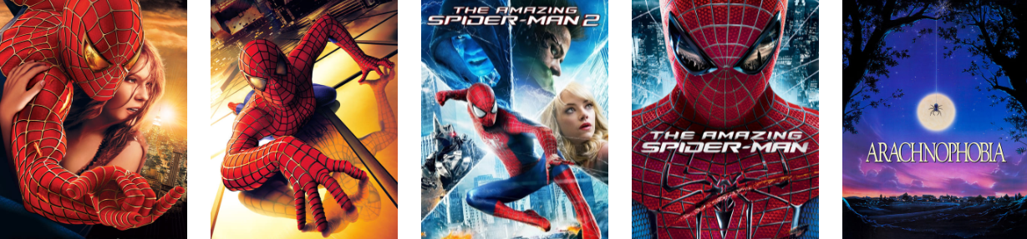
Movies Recommendation System
RISHABH GUPTA (1849210073)

Slide 2
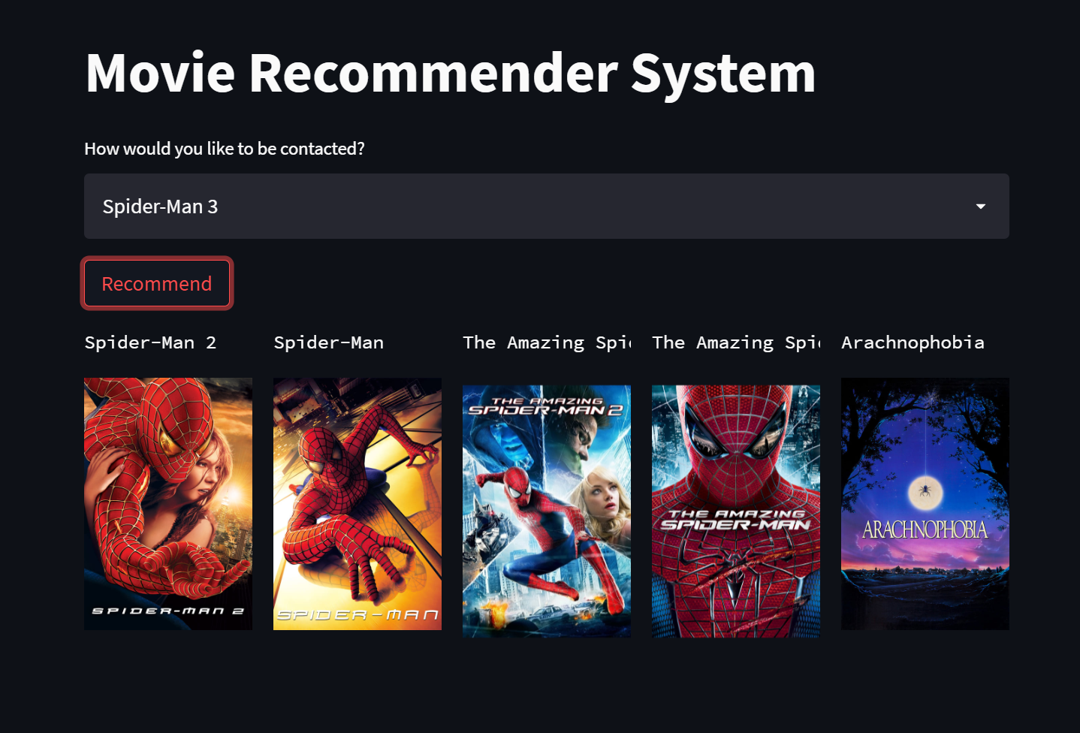
Outcome of the project
Ritvik Voleti

Slide 3
Recommendation system
Recommendation systems produce a ranked list of items on which a user might be interested, in the contest of his current choice of an item.
Subclass of information filtering system that seek to predict the ‘rating’ or ‘preference’ that a user would give to them.
Helps deciding in what to wear, what to buy, what stocks to purchase etc.
Applied in variety of applications like movies, books, research articles etc.
Recommendation systems has mainly two elements item and user.

Slide 4
Types of Recommendation system
Content Based
Collaborative
Hybrid

Slide 5
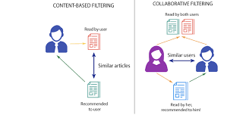
Movies Recommendation system
Content Based : The recommendation system recommends other movies which are similar to that selected movie.
Collaborative: The recommendation system recommends movies which are rated highly by the similar users.

Slide 6
Content based recommendation
It uses only the item data i.e an individual profile for each item. Each user is assumed to operate independently. No need for data on other users.
Considering the attributes or feature of the item, it finds the similarity between items and recommends the most similar item for an item.
If we consider the content of a movie as director, writer, cast etc. then each of these attribute can be considered as a feature.

Slide 7
Content based recommendation
In Content-Based Recommender, we must build a profile for each item, which will represent the important characteristics of that item.
For example, if we make a movie as an item then its actors, director, release year and genre are the most significant features of the movie. We can also add its rating from the IMDB (Internet Movie Database) in the Item Profile.
Based on the plot of a movie that was watched by the user in the past, movies with a similar plot can be recommended to the user. This approach comes under content-based filtering as the recommendations are done only based on the user’s past activity.

Slide 8
Dataset used
We have used
Tmdb_5000_movies dataset has been used from IMDB.
Tmdb_5000_credits dataset has been used from IMDB.
The total records used for this purpose for better recommendation system is 4800. Since we have developed a content based recommendation system, we have imported the attributes from Kaggle’.

Slide 9
libraries used
Numpy
Pandas
Ast
Nltk
Sklearn: Count Vectorizer, Cosine Similarity
Pickle

Slide 10
Data cleaning
Data cleaning has been done by fixing or removing incorrect, corrupted, incorrectly formatted, duplicate, or incomplete data within a dataset. When combining multiple data sources, there are many opportunities for data to be duplicated or mislabeled.
Missing Data
Irregular Data (Outliers)
Unnecessary Data — Repetitive Data, Duplicates and more
Inconsistent Data — Capitalization, Addresses and more

Slide 11
Data integration
Data Integration is a data preprocessing technique that involves combining data from multiple heterogeneous data sources into a coherent data store and provide a unified view of the data.
Data integration produces a single, unified view of a company's data that a business intelligence application can access to provide actionable insights based on the entirety of the organization's data assets, no matter the original source or format.

Slide 12
Stemming text with nltk
Stemming is one of the most widely used techniques for text normalization.
Stemming is also a type of text normalization that enables you to standardize some words into specific expressions also called stems.
Stemming helps us to standardize words that share the same suffix and that normally are derivations of grammatically similar words.

Slide 13
COUNT Vectorization with scikit
CountVectorizer is a great tool provided by the scikit-learn library in Python. It is used to transform a given text into a vector on the basis of the frequency (count) of each word that occurs in the entire text.
Stopwords are the words in any language which does not add much meaning to a sentence. They are ignored using count vectorizer technique.
We also found the 5000 most common words used in our dataset using get_feature_names function in it.

Slide 14
Cosine similarity
The movie plots are transformed as vectors in a geometric space. Therefore the angle between two vectors represents the closeness of those two vectors. Cosine similarity calculates similarity by measuring the cosine of the angle between two vectors.

Slide 15
Pickle module implementation
The pickle module implements binary protocols for serializing and de-serializing a Python object structure. “Pickling” is the process whereby a Python object hierarchy is converted into a byte stream, and “unpickling” is the inverse operation.

Slide 16
FRONT END DEV USING Pycharm ide
Streamlit is an open-source python framework for building web apps for Machine Learning and Data Science. We can instantly develop web apps and deploy them easily using Streamlit. Streamlit allows you to write an app the same way you write a python code. Streamlit makes it seamless to work on the interactive loop of coding and viewing results in the web app.

Slide 17
Heroku for deployment of web app
Heroku is a quick and easy to use Platform as a service (PaaS) that facilitates the deployment of web apps so that it is accessible to anyone with a URL. In other words, this will enable you to take your application from your local machine to the cloud. In this tutorial, We will discuss the steps to deploy apps built on Streamlit (Python) on Heroku. Heroku has been selected for deployment mainly because it provides free resource hours when you sign up for a new account.

Slide 18
Heroku for deployment of web app
We used these three files for Heroku to detect our streamlit app and instructions to execute on run. These are as follows:
1. Process files (Proc file)
2. Requirement files (requirements.txt)
3. Set up files (setup.sh)

Slide 19
applications
e-Commerce
Retail
Media
Banking
Telecom
Utilities

Slide 20
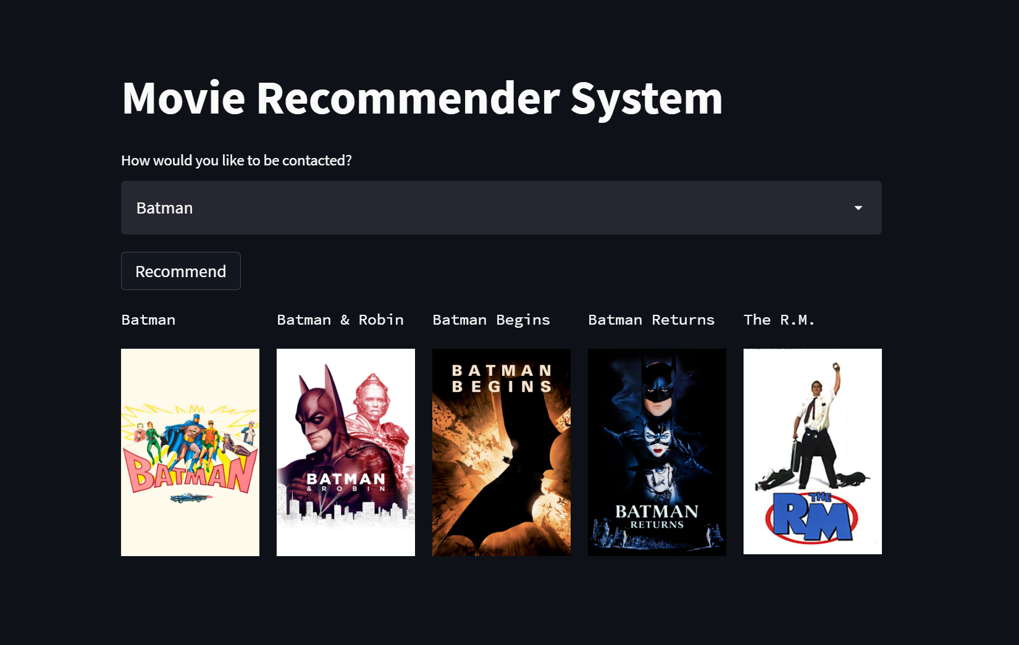

Slide 21
Thank You

